Slide 1
Software Architecture and Design I SOEN 343 Instructor: Dr. Rodrigo Morales https://moar82.github.io/ rodrigo.moralesalvarado@concordia.ca
Lecture 4c: Object Oriented advanced design principles
Notes:
1

Slide 2
Learning objectives
Understand advanced OO design principles
Apply advanced OO design principles when designing a software system
Evaluate object-oriented designs and select the best alternative based on OO advanced design principles

Slide 3
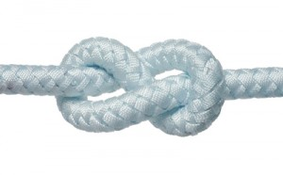
Principle of Decoupling
Tight coupling is usually bad
Why?
Hard to maintain
Hard to extend
Longer project compiling time
...
Notes:
0.5 min

Slide 4
Example: which is better?
Notes:
Assume that you are to design a GraphicDisplaySystem (GDS). The system needs to display a list of shapes (e.g., rectangle, triangle, and circle) every 0.05 second. To accomplish this task, the GDS class provides an operation called drawShapes() whose parameter is a list of Shape objects. There are two possible designs of GDS, as shown in (a) and (b), respectively.
In (a), the solution is to provide a series of operations, e.g., draw_circle(Circle), draw_triangle(Triangle), etc., where each operation handles one specific shape.
In (b), each shape is a derived class of the Shape class and has to implement a polymorphic operation called draw(). This way, when the GDS tries to display the list of shapes, a shape reference can be used to iterate through the list and call the draw() operation. Thanks to the polymorphism of OO, correct behaviors will be exhibited when the draw() operation is invoked.

Slide 5
Example: which is better?
Less dependency
Easy expansion
Simplicity and elegancy in implementation
Notes:
2 min

Slide 6
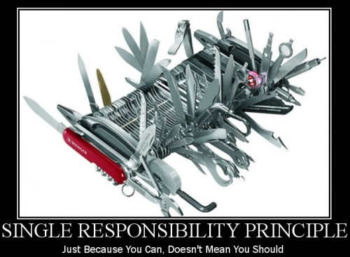
Single responsibility principle (SRP)
A Class should have one reason to change
A Responsibility is a reason to change
Single Responsibility = increased cohesion
Not following results in needless dependencies
More reasons to change.
Rigidity, Immobility

Slide 7
Example: An Initial Design of Professor Class
Notes:
A Professor class provides services to both students and the registrar's office. Students can invoke operations such as getLectureNotes(), and getAssignment() to retrieve course materials. The registrar's office can invoke an operation called prepareGradApp() to ask the professor to prepare a graduation application for one of his/her advisees. To prepare a graduation application, a professor needs to verify whether the student's current transcript satisfies the degree requirements by invoking private operations such as verifyDegree() and adviseCurriculum().
As shown in Figure above both the Student and RegistrarOffice classes depend on the Professor class.

Slide 8


Business Logic
Professor provides service to students
Teaching
Preparation of Graduation Applications
Problem?
The Professor class bears two functionalities
Design is not cohesive
Notes:
One solution to improve the design in the previous slide is to specialize the Professor class into two subclasses:
an Advisor class and an Instructor class.
The corresponding attributes and operations can be moved down to those classes, leaving the shared attributes and operations up in the root Professor class.

Slide 9
Improved Design
Notes:
If the Professor class cannot be specialized, the use of inheritance and public interface can help improve cohesion.
One sample solution is shown in the Figure above.
Two new interfaces are defined in the improved design: Advisor and Instructor.
These interfaces declare the operations that must be realized by the derived classes, e.g., prepareGradApp() and getLectureNotes().
The Professor class realizes these two interfaces.
In addition, when the Student and the RegistrarOffice need to access the corresponding functions provided by the Professor class, they do not directly refer to the Professor class. Instead, they depend on the Advisor and Instructor interfaces.
Such minor changes in class relationships can greatly improve the cohesion of the overall design.

Slide 10
Open-Closed Principle
Open to Extension
The system can be extended to meet new requirements
Close to Modification
The existing implementation should not be modified
How to do it?
Inheritance and polymorphism
Notes:
The OCP is all about allowing change, but doing it without requiring you to modify existing code

Slide 11
Example
the draw() method is defined in the base class and does not change
all of the subclasses can change the behavior of draw
Notes:
Shape is closed for modification; the draw() method is defined in the base class and does not change. But it is open for extension, because all the subclasses can change the behavior of draw

Slide 12
Guidelines to apply the OCP principle
How?
Separate interface and implementation
Encapsulate what varies.
Better to have an abstract interface class and then a concrete class
Depend on interface classes only
Avoid Modifying:
Classes and/or Interfaces that already exist
Keep attributes private
Don’t expose attributes if not necessary
Exception:
Fixing bugs in existing code

Slide 13

Liskov Substitution Principle
“If for each object o₁ of type S there is an object o₂ of type T such that for all programs P defined in terms of T, the behavior of P is unchanged when o₁ is substituted for o₂ then S is a subtype of T.”
(Barbara Liskov, 1988)

Slide 14
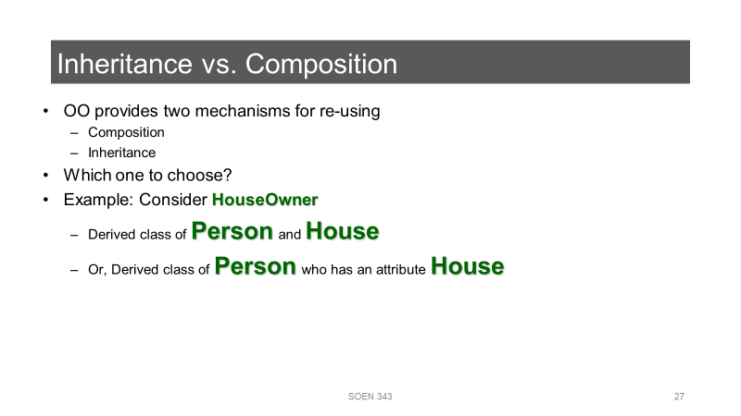
Liskov Substitution Principle
Simply put, if class A is a subtype of class B, then we should be able to replace B with A without disrupting the behavior of our program.
Derived classes should require no more and promise no less.
A child class should never change the characteristics of its parent class (such as the argument list and return types)
You can follow the Liskov Substitution Principle by paying attention to the correct inheritance hierarchy.

Slide 15
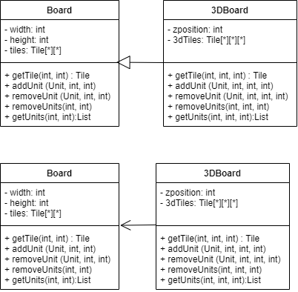
Example
You are a developer in a game company working in a project of a strategy board game similar to Risk
The Board functionality is represented in the class Board
Class board supports 2D boards, where you can please army units in a x,y coordinated system

Slide 16
Exercise
Suppose that one of the clients wants to enhance it to create World War II air battles. You are asked to take the basic Board type and enhance it to support a 3D board to represent the position of units on the sky.
What you would do?
a)
Notes:
Extend class board with a 3DBoard class that provides methods and attributes to handle the 3rd dimension (z coordinate)
what is the problem with this design?

Slide 17
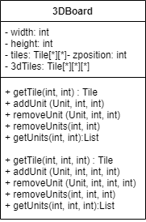
Exercise
Suppose that one of the clients wants to enhance it to create World War II air battles. You are asked to take the basic Board type and enhance it to support a 3D board to represent the position of units on the sky.
What you would do?
a)
Even though some of these methods aren’t
defined on 3DBoard, they’re all inherited form the base class Board
Notes:
When you use inheritance, your subclass gets all the methods from its superclass, even if you don’t want those methods. And if you’ve used inheritance badly. then you're going to end up with a lot of new methods that you don ‘t want, because they probably don't make sense on your subclass.

Slide 18
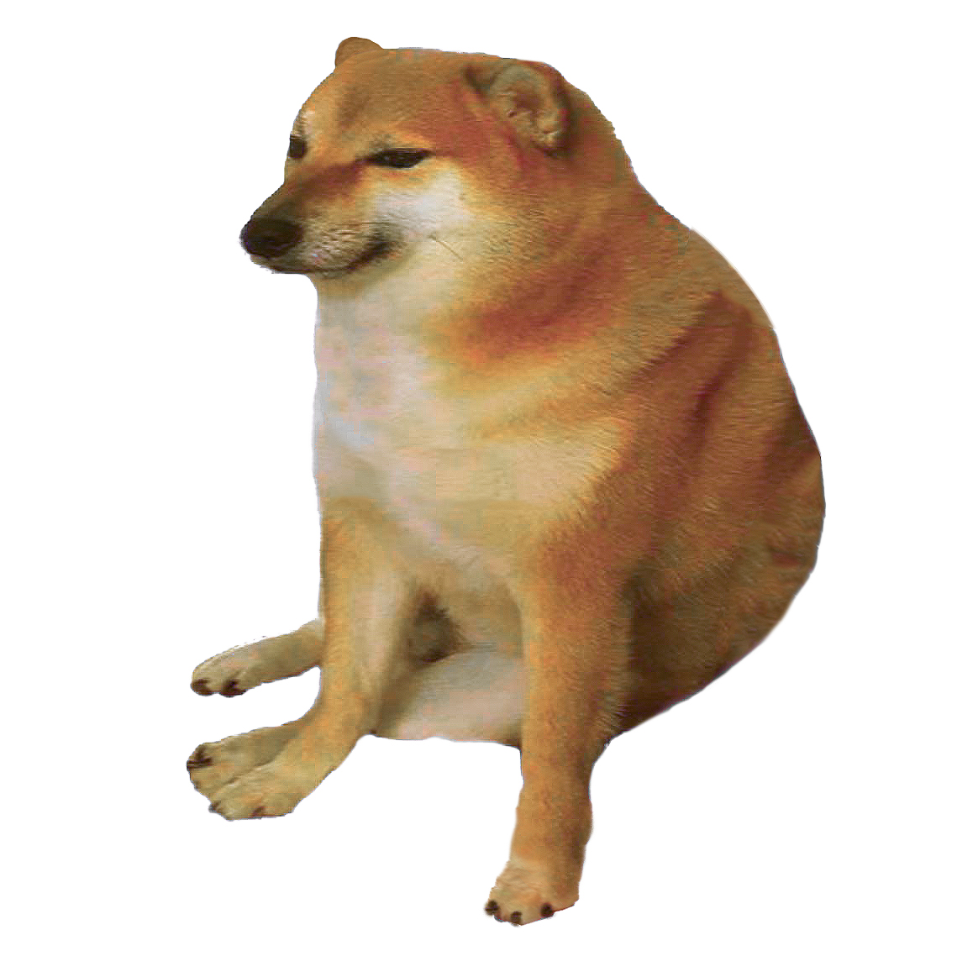
Exercise
Suppose that one of the clients wants to enhance it to create World War II air battles. You are asked to take the basic Board type and enhance it to support a 3D board to represent the position of units on the sky.
What you would do?
Hmm, I’m not sure which version of getTile() and addUnit() to use
a)
Notes:
It is hard to understand code that misuses inheritance.

Slide 19
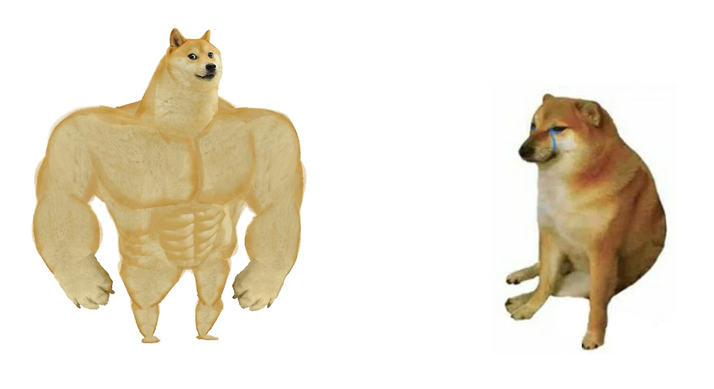
Exercise
Suppose that one of the clients wants to enhance it to create World War II air battles. You are asked to take the basic Board type and enhance it to support a 3D board to represent the position of units on the sky.
What you would do?
The 3DBoard class delegates a lot of its functionality to the individual Board instances
b)
Notes:
b) Associate class board with a 3DBoard class that provides methods and attributes to handle the 3rd dimension (z coordinate)
Instead of extension, we’re using an association. So 3DBoard can use the behavior of Board, without having to extend from it and violate the LSP.
3DBoard can store an array of Board objects, and end up with a 3D collection of boards.
The 3D board methods use the zpos coordinate to figure out which Board instance in the array to use, and then delegates the (x,y) cords to that Board’s function.
This is a form of delegation. The 3DBoard class delegates a lot of its functionality to the individual Board instances.

Slide 20
Exercise
Suppose that one of the clients wants to enhance it to create World War II air battles. You are asked to take the basic Board type and enhance it to support a 3D board to represent the position of units on the sky.
What you would do?
These methods look a lot like the methods in Board, but they need to use the functionality in Board, rather than extend it. So inheritance isn’t a good option here
b)

Slide 21
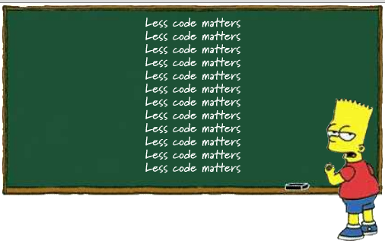
Don’t Repeat Yourself principle
DRY states to abstract out the code that is duplicated and putting it in a single location
It discourages repetitive code
It reduces maintenance overhead

Slide 22
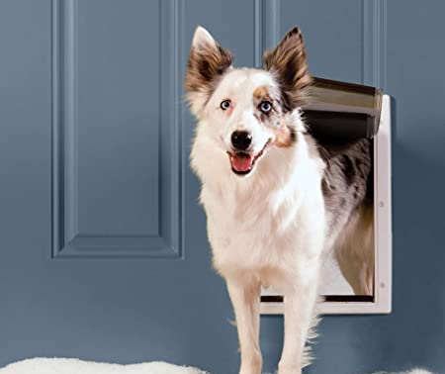
DRY principle example
You are developing a smart home subsystem to automate your dog’s door
Currently the system open the door on the following situations:
You send a command through the smart home mobile app
Your dog barks at the door (yes, we have device that recognize your dog’s voice!)
You are asked to add new feature to close the door automatically after 5 seconds

Slide 23
DRY principle example
Without DRY principle, your code look like this:
class Remote.java class BarkRecognizer.java
public void openDoorButtonPressed(){
System.out.println(
"Pressing the open door button...");
door.open();
//close the door after a time interval
final Timer timer = new Timer();
timer.schedule (new TimerTask() {
public void run() {
door.close();
timer.cancel();
}
}, 5000);
}
public void recognize(String bark){
System.out.println(
"BarkRecognizer: Heard a "+ bark + "...");
door.open();
//close the door after a time interval
final Timer timer = new Timer();
timer.schedule (new TimerTask() {
public void run() {
door.close();
timer.cancel();
}
}, 5000);
}
Notes:
Cheems suggested to put the same code in BarkRecognizer, but according to DRY that’s a bad idea. a.k.a., code duplication

Slide 24
DRY principle solution
Bark
Recognizer.
java
Abstract out the common code
Remote.java
public class DogDoor{
public void open() {
System.out.println("The dog door opens.");
open = true;
final Timer timer = new Timer();
timer.schedule (new TimerTask() {
public void run() {
door.close();
timer.cancel();
}
}, 5000);
}
Notes:
Using DRY, we first need to take the code that's common between Smart Home app class and BarkRecognizer and put it in a single place. The best place for it is in the DogDoor class

Slide 25
DRY principle solution
Remove the code from other locations…
public void openDoorButtonPressed(){
System.out.println(
"Pressing the open door button...");
door.open();
//close the door after a time interval
final Timer timer = new Timer();
timer.schedule (new TimerTask() {
public void run() {
door.close();
timer.cancel();
}
}, 5000);
}
public void recognize(String bark){
System.out.println(
"BarkRecognizer: Heard a "+ bark + "...");
door.open();
//close the door after a time interval
final Timer timer = new Timer();
timer.schedule (new TimerTask() {
public void run() {
door.close();
timer.cancel();
}
}, 5000);
}
Notes:
We got rid of this code… it’s all in DogDoor’s open() method now
We don’t have to explicitly call the code we abstracted out… that’s handled already by our call to door.open()

Slide 26
Summary
Principle of decoupling
Open-Closed principle
Liskov substitution
DRY principle
Notes:
We present the steps of OO Analysis and design

Slide 27
References
Ch. 3. Qian, Kai, et al. Software architecture and design illuminated. Jones & Bartlett Learning, 2010.
Ch. 8. McLaughlin, Brett, Gary Pollice, and David West. Head First Object-Oriented Analysis and Design." O'Reilly Media, Inc.", 2007.

